Slide 1
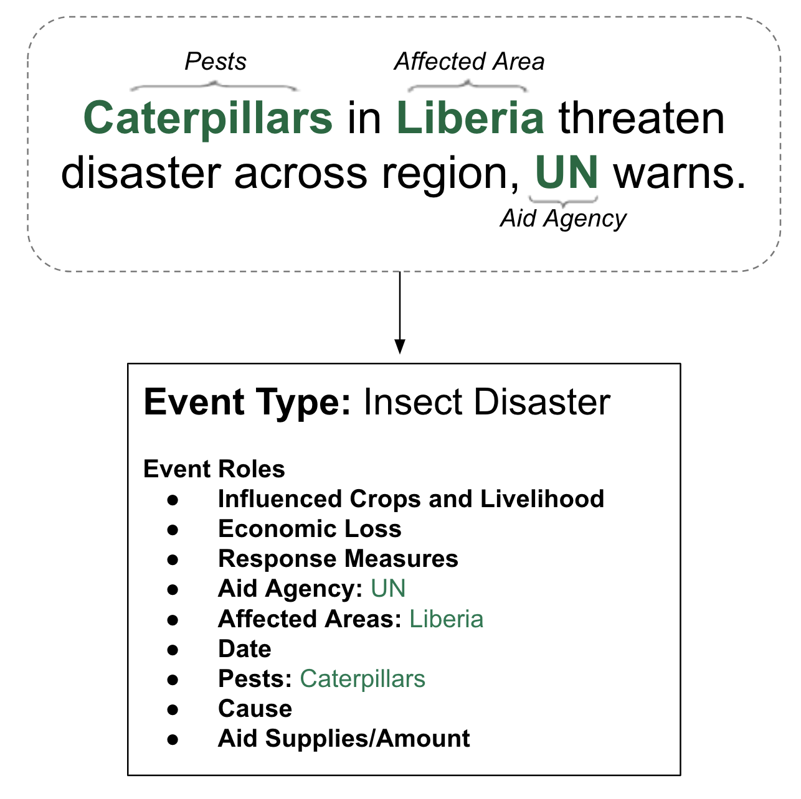
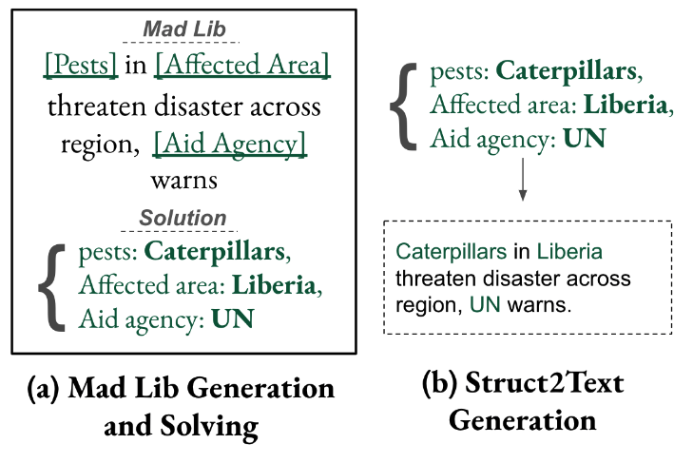
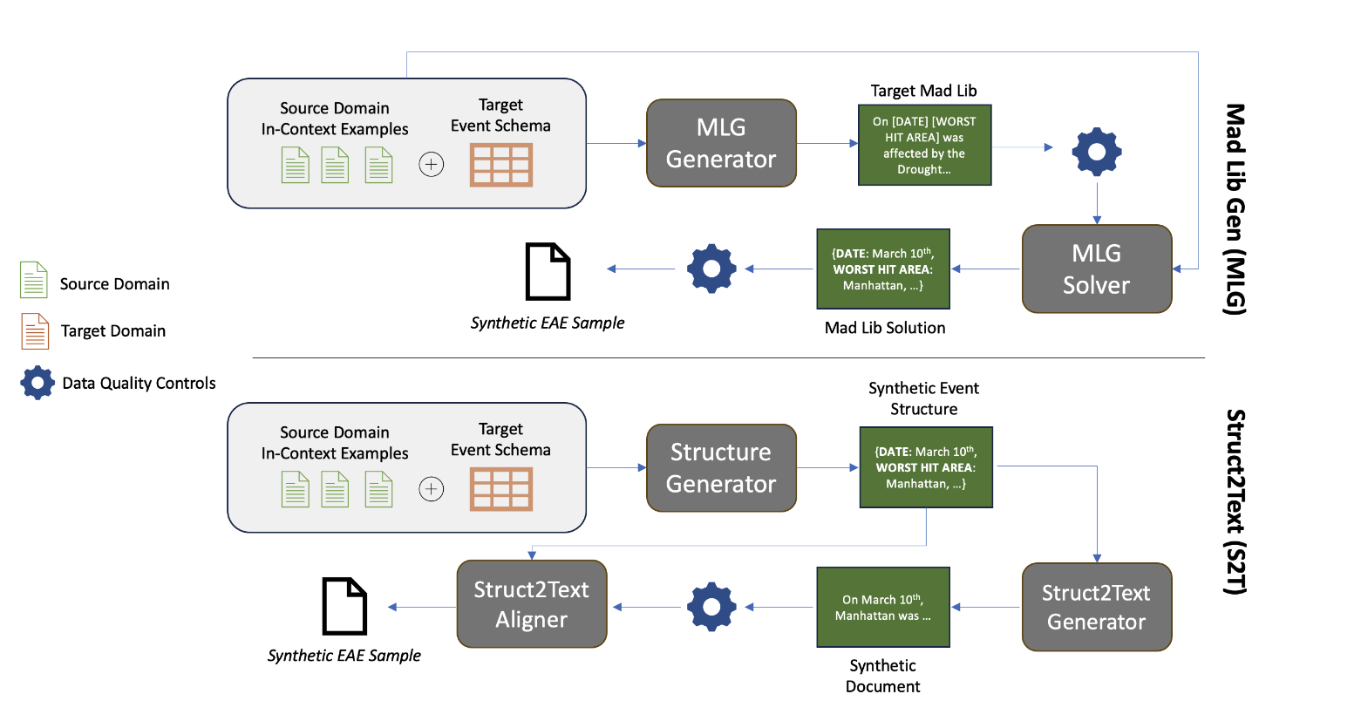
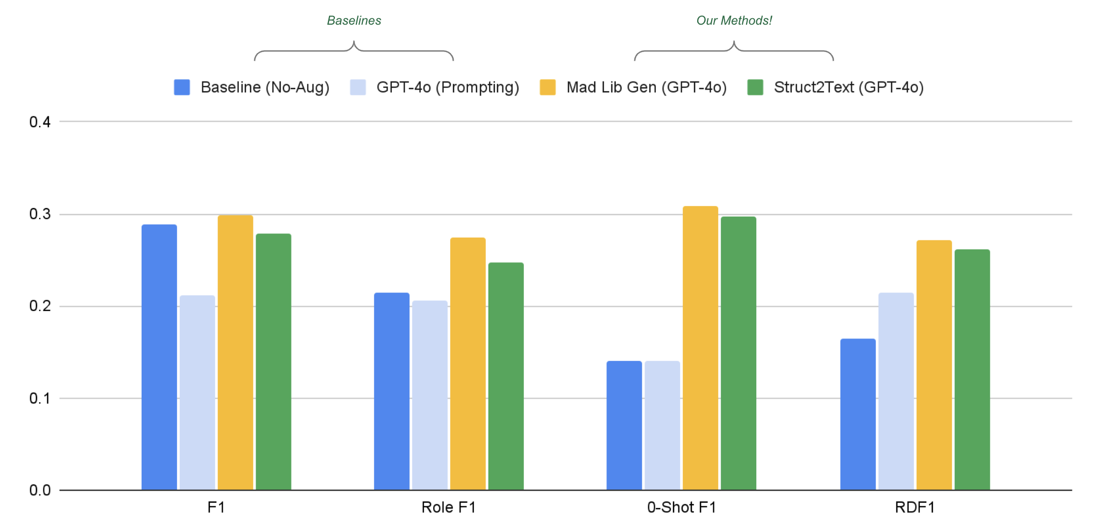
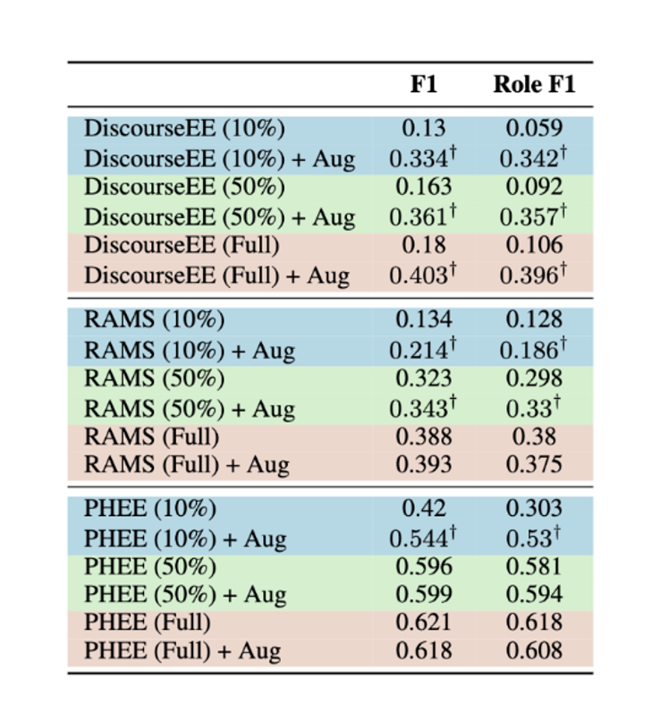

Document-Level Event-Argument Data Augmentation for Challenging Role Types
Joseph Gatto, Omar Sharif, Parker Seegmiller, Sarah Preum
Dartmouth College, Department of Computer Science
PROBLEM
OUR SOLUTION
Event argument extraction (EAE) from long documents is very challenging.
Document-Level EAE (DocEAE) data collection for new domains is extremely expensive.
Goal: We want to synthesize novel documents for DocEAE training
Key: LLMs struggle to synthesize long documents (10+ sentences) for span annotation tasks like DocEAE!
Novel Inference Framework: We introduce two methods for DocEAE data generation that meet the following criteria:
🡪 Cross-Domain Generation: Our methods use zero in-domain training samples to create new training data, relying on out-of-domain data + LLM parametric knowledge. This enables generation of long-tail role types.
🡪 LLM Span Generation Alignment: Each of our methods ensures the desired event argument has accurate span annotation in the synthesized document.
Example of the Event Argument Extraction (EAE) task
Methods: We can generate novel EAE samples in low-resource domains using zero in-domain data.
Experiment #1: Can we improve few-shot, cross-domain performance on document-level EAE?
Experiment #2: Does MLG improve performance on standard EAE tasks?
Metric | Description
F1 | Standard F1 On All Data
Role F1 | Compute F1 For Each Role Individually, Then Take Average
0-Shot F1 | Role F1 for 0-Shot Roles (n=9)
Role-Depth F1 (RDF1) | Role F1 for Semantically Outlying Roles (n=16)
Result #1: On the DocEE few-shot cross-domain data split, both methods provide significant improvement on 0-shot and semantically outlying role types!
Result #2: Our data augmentation strategy improves low-resource performance on DiscourseEE, RAMS, and PHEE.

